Slide 1
Programing Principles
Programing Principles | MTI Technology| techvn\thangpd

Slide 2
STRUCTURE OF THE PRESENTATION
Definition
Purpose: Understand concepts and principles
Advantages and disadvantages
Purpose: Compare the pros and cons of each principle
In case of used
Purpose: Know under what circumstances the rules should apply
Conclusion
Purpose: Conclusion of the study

Slide 3
DEFINITION
SOLID
SOLID is an acronym for the first five object-oriented design (OOD) principles
Single Responsibility Principle
Open/ Closed Principle
Liskov Substitution Principle
Interface Segregation Principle
Dependency Inversion Principle

Slide 4
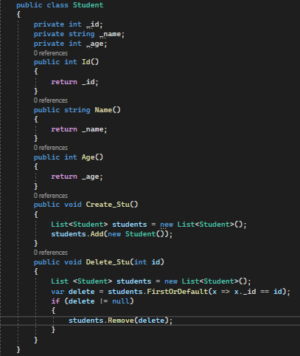
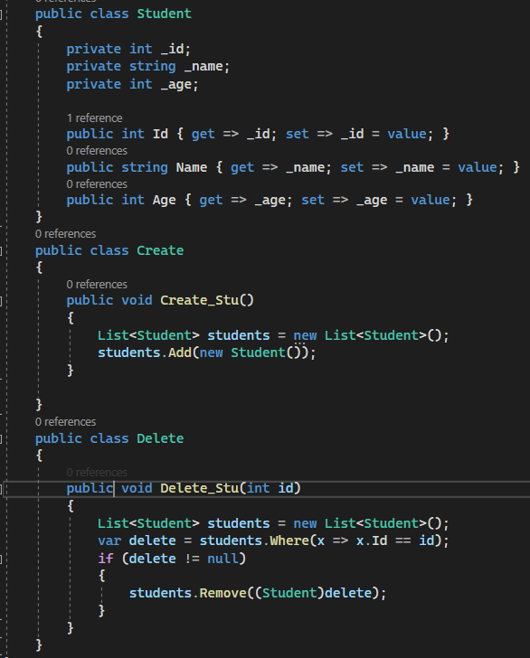
DEFINITION
Single Responsibility Principle
A class should have one and only one reason to change, meaning that a class should have only one job.

Slide 5
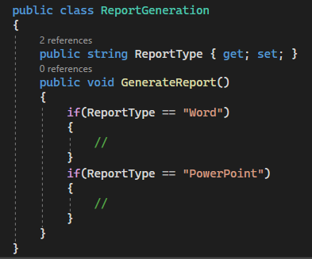
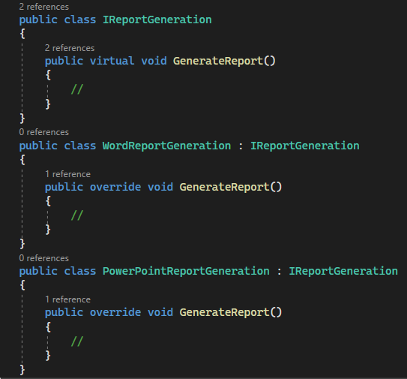
DEFINITION
Open/ Closed Principle
Objects or entities should be open for extension but closed for modification.

Slide 6
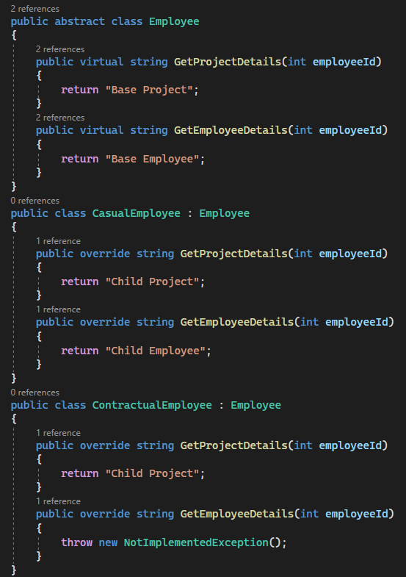
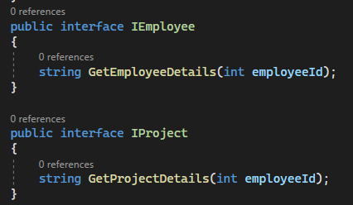
DEFINITION
Liskov Substitution Principle
Subtypes must be substituable for their base types.

Slide 7
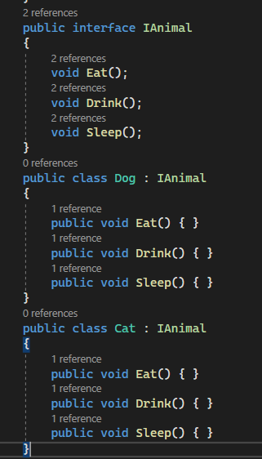
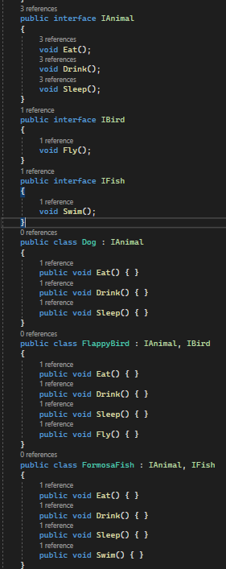
DEFINITION
Interface Segregation Principle
A client should never be forced to implement an interface that it doesn’t use, or clients shouldn’t be forced to depend on methods they do not use.

Slide 8
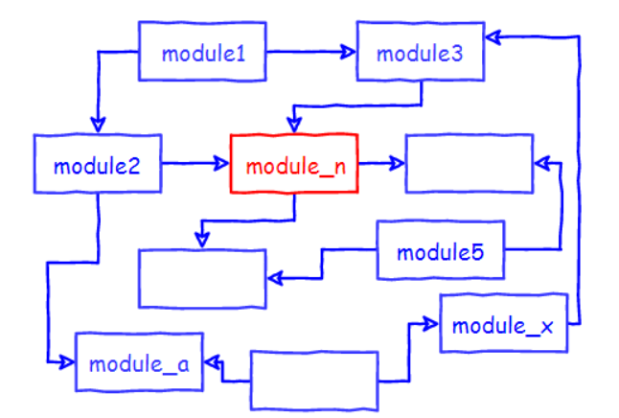
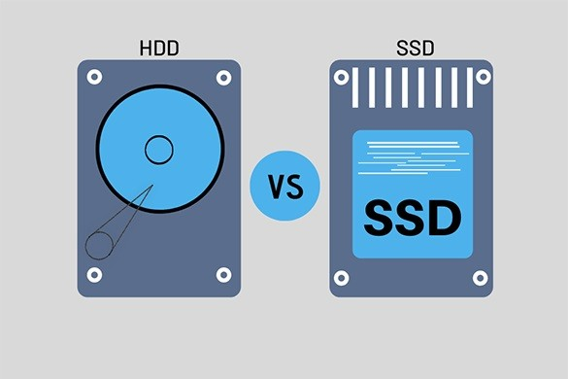
DEFINITION
Dependency Inversion Principle
Entities must depend on abstractions, not on concretions. It states that the high-level module must not depend on the low-level module, but they should depend on abstractions.

Slide 9
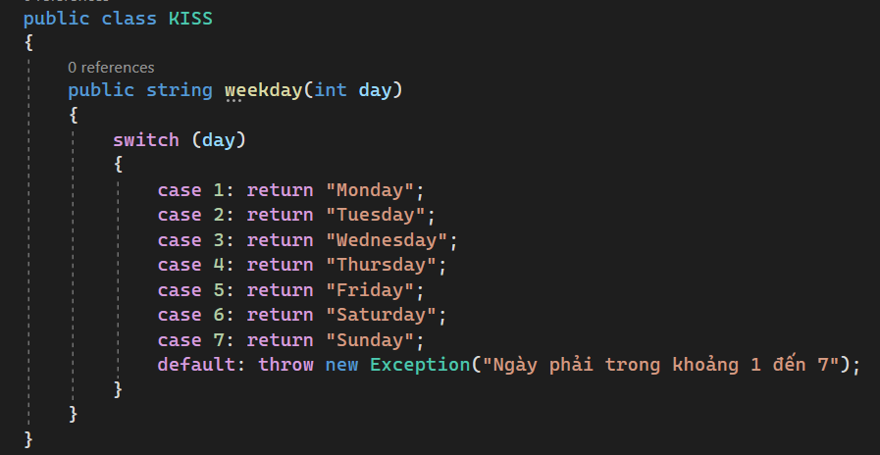
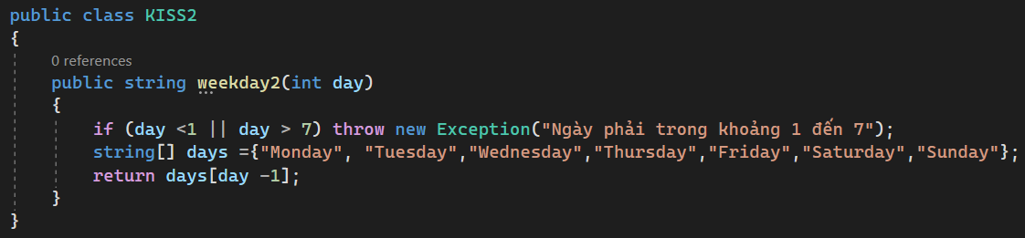
DEFINITION
KISS
“Keep It Short and Simple” or “Keep It Simple and Straightforward” or “Keep It Small and Simple”

Slide 10

DEFINITION
YAGNI
“You Aren’t Gonna Need It”

Slide 11
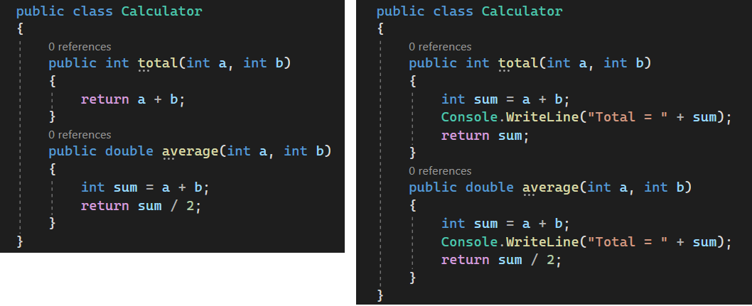
DEFINITION
DRY
“Don’t Repeat Yourself”

Slide 12
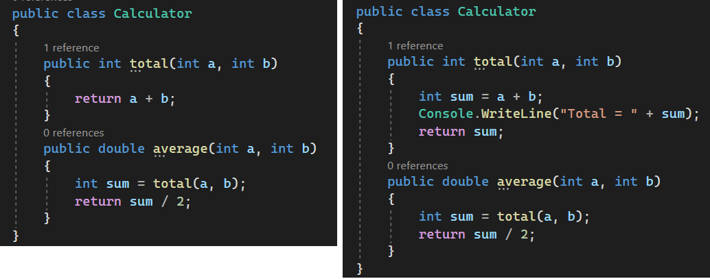
DEFINITION
DRY
“Don’t Repeat Yourself”

Slide 13
ADVANTAGES AND DISADVANTAGES
 | SOLID | KISS | YAGNI | DRY
Advantages | Applications in OOP programming. 3 factors: understanding, ease of maintenance, flexibility. Think more about how to write software. Flexible refactoring capabilities. | Issues are resolved faster, avoiding complex problems. Easy-to-use, easy-to-test code Easily maintain and update the code as needed. | Programmers focus on their own tasks, neither wasting time nor risking thinking “it will be useful in the future”. | Code less, which saves time and effort, is easy to maintain, and also reduces the risk of errors.
Disadvantages | Recommended for large systems only. Use more Interfaces. Takes a long time to develop and increases project costs. | When combined with the YAGNI principle, the programmer's passive ability in software development | In contrast to SOLID, which easily leads to thinking about sufficient features, the more minimalist the architecture, the better: No need to be flexible, no need to anticipate the problem of busniess will develop, wherever the requirements are, the architecture will come. | In the case of complex code, which is reused in many places, using the DRY principle is prone to technical debt errors (Technical Debt).

Slide 14
IN CASE OF USED
SOLID | KISS | YAGNI | DRY
Commonly used in OOP programming, combined with 4 characteristics of OOP programming to increase application efficiency | Apply to name functions, variables, methods, classes, annotations explicitly. Break the task into smaller tasks for coding. Limit each method to 30-50 lines, and each method should only perform 1 function. Don't use multiple If statements in one method, separate it into different methods | There's nothing wrong with "pragmatic" thinking in applying YAGNI in your work however No need to build hypothetical features early, instead, always prepare yourself for any change by making the source code more flexible and abstract code | When you have to change a function/class, do you want all the places they are used to update? Is the same code a duplicate? There are not such as in the future?

Slide 15
CONCLUSION
Regardless of the principles applied, the overall goal is to get the program to work with good performance and code that's easy to see and understand. The system develops, expands, and maintains everywhere becomes simpler, avoiding disorder.

